Slide 1
2-Dimensional Arrays

Slide 2
Arrays
An array is a collection of data items of same data type
Arrays are of two types:
  One-dimensional arrays
  Multidimensional arrays

Slide 3
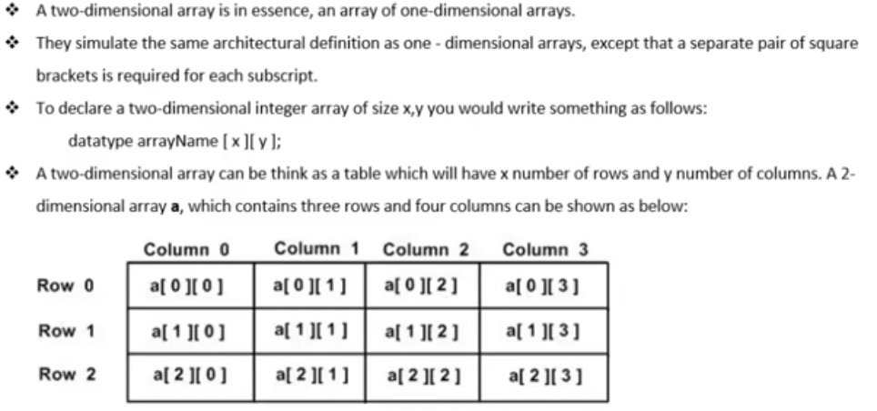

Slide 4
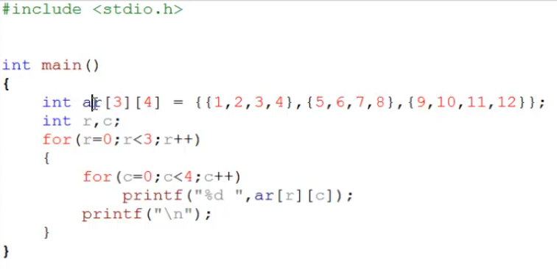

Slide 5
Declaration of Two-dimensional array
To declare a two-dimensional array, we merely use two sets of square brackets.
  The first contains the number of rows
  The second contains the number of columns
Syntax:
data_type array_name[row_size][column_size];
For example: int a[10][15];
float b[2][3];

Slide 6
Initializing Two-Dimensional Arrays
int a[3][4] {
{0, 1, 2, 3} , /* initializers for row indexed by 0 */
{4, 5, 6, 7} , /* initializers for row indexed by 1 */
{8, 9, 10, 11} /* initializers for row indexed by 2 */
};

Slide 7
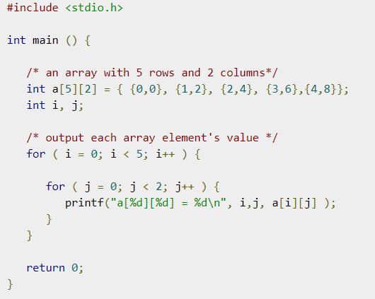
Accessing Two-Dimensional Array Elements
An element in a two-dimensional array is accessed by using row index and column index of the array. For example

Slide 8
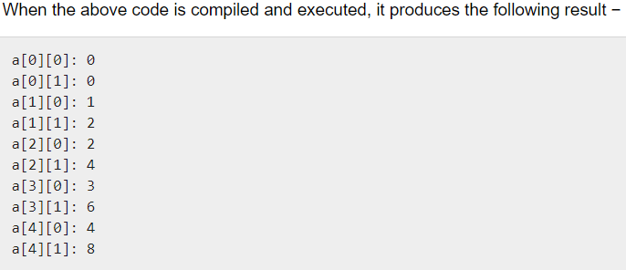

Slide 9
Example
Write a C program to find sum of two matrix of order n*n.

Slide 10
